Slide 1
Rshiny App Demo
Pang-Yu Liu (Data Programmer I)

Slide 2
Agenda
Why create this Rshiny app?
How to create this app?
What kind of problem I solved?

Slide 3

Why create this Rshiny app?
I faced a data processing problem when I was doing my RDCRN request.
In order to solve this problem in the future, I developed an Rshiny app for it.
Continuing Education (CE)! Learn from projects!

Slide 4

Data processing problem
Create a derived dataset whose fields (variables) comes from different instruments.
If the derived dataset contains 20 or more different instruments? (Tons of work!)
Ex : A dataset contains some “Demographics” variables (age, gender, date of birth, etc) and some “Laboratory” related variables.
Demographics variables
Derived dataset
Laboratory variables

Slide 5



Traditional programming methods
1. Obtain required individual instruments, then uses SAS to merge.
2. Obtain entire dataset, then keeps required variables.
3. Why not combine R shiny and REDCap??? (Just Click button! No more programming!)

Slide 6
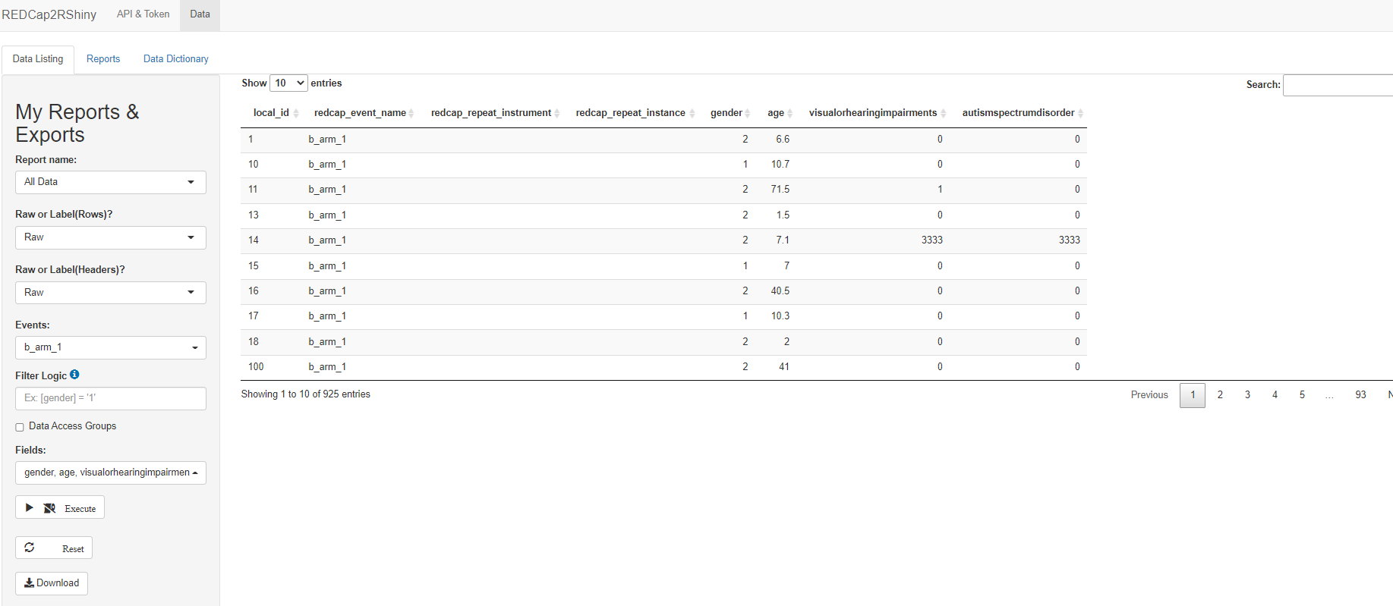
Innovative Method
Result!

Slide 7
Demo Time!

Slide 8
FAQ

